Slide 1
Normalization
Key Concepts:
Need for Normalization
Update, Insertion, & Deletion Anomalies
First Normal Form
Second Normal Form
No partial dependencies
Third Normal Form
No transitive dependencies
Database Oath: Every non-key attribute is dependent on the key, the whole key, and nothing but the key.
Boyce-Codd Normal Form
Fourth Normal Form
Denormalization

Slide 2
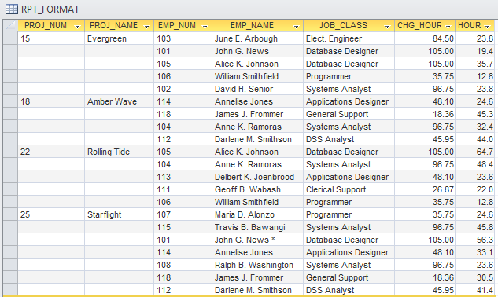
Need for Normalization – Example

Slide 3
Problems with This Table
What is the PK?
Perhaps PROJ_NUM. But there are nulls in that column.
Probably PROJ_NUM + EMP_NUM is the intented PK.
Potential Inconsistencies
Many employees have the same job class. The JOB_CLASS might be entered as "Database Designer" in one place and "DB Designer" in another.
Update Anomaly
A change of a single data value requires multiple changes in other elements.
E.g. Alice Johnson's JOB_CLASS changes.
Insertion Anomaly
There does not appear to be any reasonable way to assign attribute values to a new entry.
E.g. An employee is added who is not assigned to a project.
Deletion Anomaly
Removal of a record results in a loss of important information.
E.g. If there is only one employee on a particular project and that employee leaves, deleting that row will delete the project information also.

Slide 4
Need for Normalization
Data redundancy refers to the same data being duplicated in multiple places in a database. This can create anomalies and inconsistencies when that data is changed or updated.
"DRY" – Don't Repeat Yourself.
Normalization is a process of modifying database tables to minimize data redundancy.
Goals of normalization:
Each table represents a single subject.
No data item is unnecessarily stored in more than one table.
Each table has no insertion, update, and deletion anomalies.

Slide 5
First Normal Form
A table is in 1st normal form (1NF) if there are no repeating groups (multiple entries associated with the same value of an attribute), and the PK is identified.
Strictly speaking, by the definition of a relational table, all relational tables are 1NF.
NOTE: Multi-valued attributes do NOT violate 1NF.
To convert a non-relational table to 1NF:
Eliminate all repeating groups.
Usually by removing nulls.
Identify the PK.
All attributes must be dependent on the PK.
All columns in the PK are needed.

Slide 6
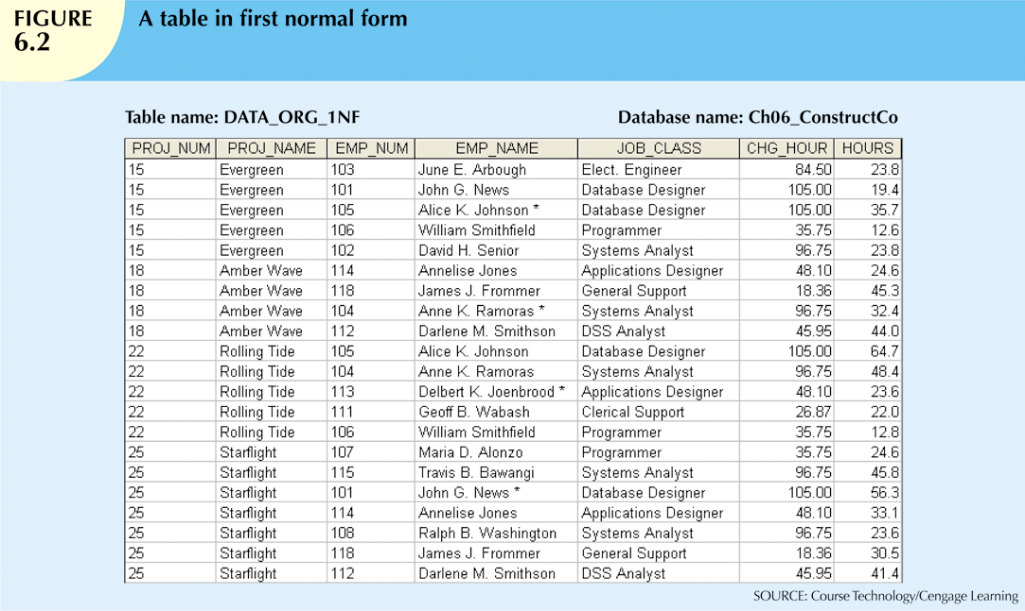
1NF - Example
PK is PROJ_NUM + EMP_NUM.

Slide 7
Partial Dependencies
(1) A set of attributes B (the "dependent") is functionally dependent on a set of attributes A (the "determinant") if all rows in the table that agree in value for all attributes in A also agree in value for all attributes in B; denoted by A -> B .
(2) A candidate key is any set of attributes that determines all attributes and is minimal (i.e. if any attribute is removed, it no longer determines all attributes).
A candidate key could be chosen as primary key.
A partial dependency is a functional dependence in which the determinant is part, but not all, of a candidate key.
E.g. (1) PK is columns A and B;
(2) some other column(s) is dependent on B alone.
E.g. PROJ_NUM -> PROJ_NAME.

Slide 8
2nd Normal Form
A table is in 2nd normal form (2NF) if it is in 1NF and there are NO PARTIAL dependencies.
NOTE: Any 1NF table whose PK consists of one attribute is automatically 2NF.
Why? If the PK is one attribute, then any candidate key can be only one attribute, so there is no way for something to depend on PART of any candidate key.
Thus the issue of 2NF only arises if the PK is a composite key (consists of more than one attribute).

Slide 9
Converting to 2NF
To convert from 1NF to 2NF:
Identify all partial dependencies;
Make new tables to eliminate partial dependencies.
(1) Identify all partial dependencies:
(a) Identify all the attributes that are functionally determined by the whole primary key (full dependency).
(b) Look for attributes that are functionally determined by only part of the primary key (partial dependency).
In this example, look for attributes that are functionally determined by PROJ_NUM and not EMP_NUM.
Then look for attributes that are functionally determined by EMP_NUM and not PROJ_NUM.
(c) Draw all the dependencies in a dependency diagram.

Slide 10
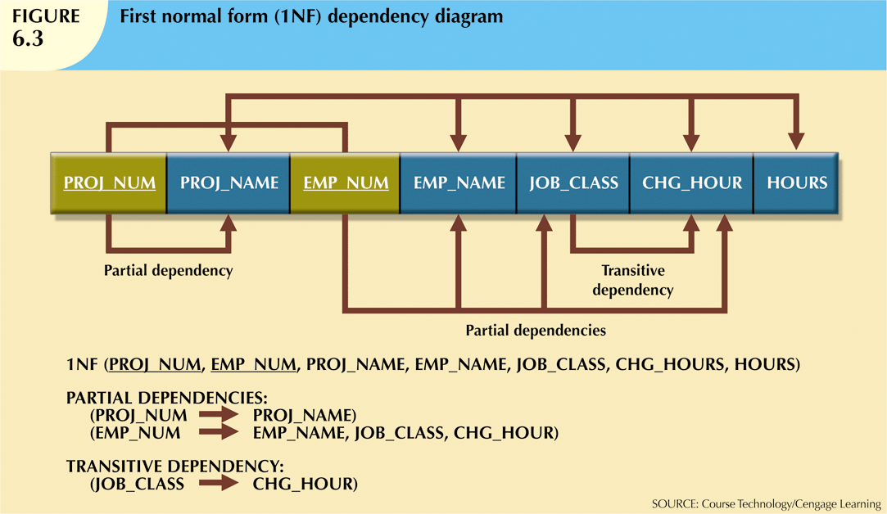
Dependency Diagram
Desirable dependencies are above, undesirable ones below.

Slide 11
(2) Eliminate Partial Dependencies
To eliminate partial dependencies:
(a) For each component of the PK that is a determinant in a partial dependency, create a new table with a copy of that component as PK. The determinant remains in the original table as an FK and part of the PK.
(b) The attributes that are dependent in a partial dependency are removed from the original table and placed in the new table with their determinant.
In this example:
Make a new table with PK PROJ_NUM and column PROJ_NAME.
Make a new table with PK EMP_NUM and columns EMP_NAME, JOB_CLASS, and CHG_HOUR.
The original table contains only PROJ_NUM, EMP_NUM and HOURS (renamed to ASSIGN_HOURS to match the name of the new table.)

Slide 12
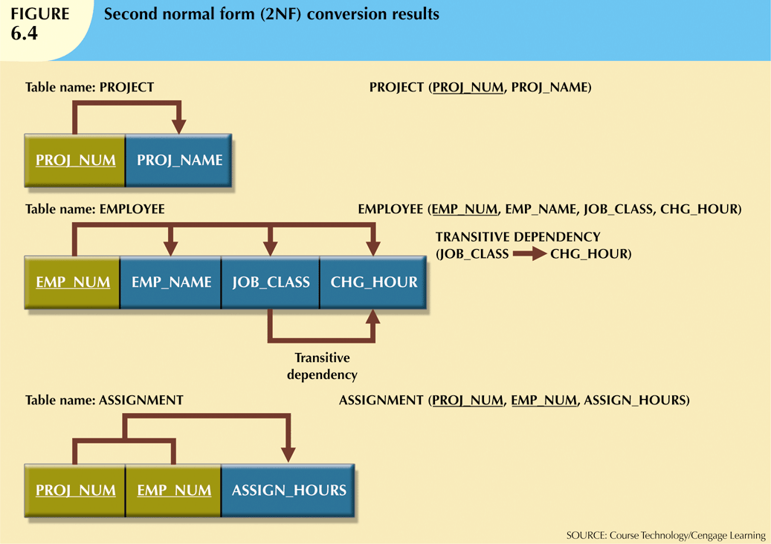
Result of Conversion to 2NF
FK
FK
PK
The update, insertion and deletion anomalies described earlier have been addressed.
Each of these changes now requires making only one change in one table.

Slide 13
Transitive Dependency
A nonprime (or nonkey) attribute is an attribute not part of any candidate key.
A transitive dependency is a functional dependence of one nonprime attribute on one or more nonprime attributes.
E.g. JOB_CLASS -> CHG_HOUR.
The name comes from the fact that if nonprime attribute Y determines nonprime attribute Z, then we have PK -> Y and Y -> Z, so PK -> Z by transitivity. PK does not determine Z directly.
Transitive dependencies can also cause anomalies.
E.g. if the CHG_HOUR for the JOB_CLASS "Database Designer" changes, multiple rows have to be changed.

Slide 14
3rd Normal Form
A table is in 3rd normal form (3NF) if it is in 2NF and there are NO TRANSITIVE dependencies.
To convert to 3NF, eliminate transitive dependencies in the same way that partial dependencies were eliminated.
(a) For each attribute that is a determinant in a transitive dependency, create a new table with a copy of that component as PK. The determinant remains in the original table as a FK.
(b) The attributes that are dependent in a transitive dependency are removed from the original table and placed in the new table with their determinant.
In this example:
The transitive dependency is JOB_CLASS -> CHG_HOUR.
Make a new table with PK JOB_CLASS and column CHG_HOUR.
Remove CHG_HOUR from the EMPLOYEE table.

Slide 15
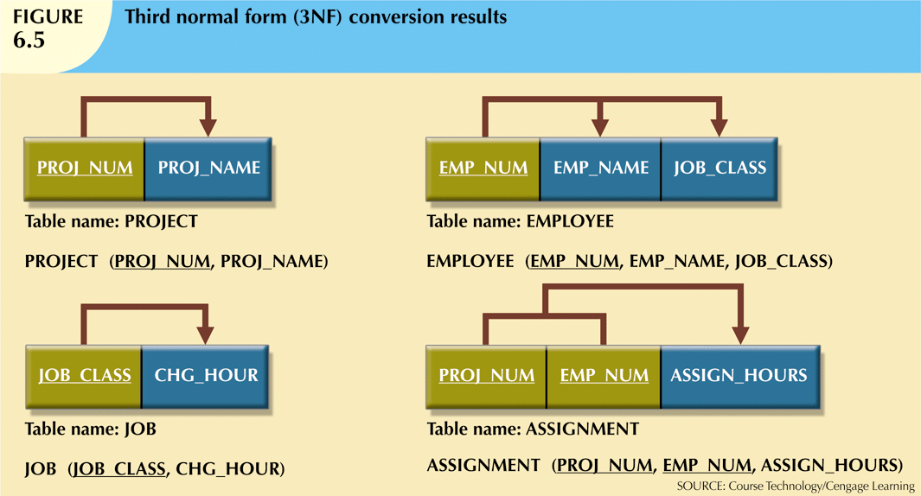
Result of Conversion to 3NF
FK
FK
PK
FK

Slide 16
Database Oath
The first 3 normal forms can be remembered using the “database oath”:
Every [non-key] attribute depends on the key, the whole key, and nothing but the key.
Some people add "so help me Codd".
Existence of "the key" says that that the table is 1NF;
Requiring that non-key attributes be dependent on "the whole key" says that the table is 2NF;
Requiring that non-key attributes be dependent on "nothing but the key" says that the table is 3NF.
<<Do in-class exercise here>>

Slide 17
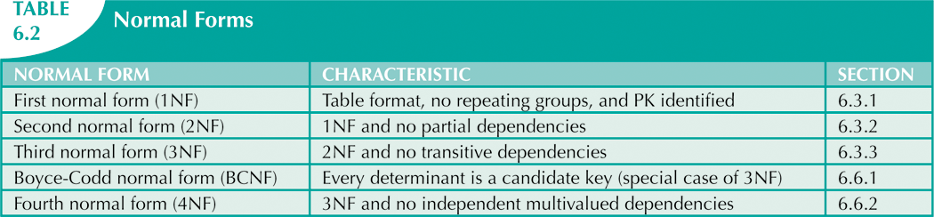
Other Normal Forms
Tables in 3NF perform suitably in most environments. Higher-order normal forms are useful on occasion.
We will cover Boyce-Codd normal form (BCNF) and Fourth normal form (4NF).
But there are even more (Fifth normal form (5NF) and domain-key normal form (DKNF)).
Fifth normal form (5NF)
Domain-key normal form (DKNF)

Slide 18
Candidate Keys
Why do all the definitions involving normalization refer to candidate key rather than just the primary key?
Consider HR.Employees in TSQL2012. The PK is empid. Candidate keys include lastname, firstname and others.
If candidate keys were not part of the definition, then, for example, lastname -> address would be a transitive dependency. But there would be no point in moving that dependency into its own table; no data duplication would be reduced.

Slide 19
Boyce-Codd Normal Form (BCNF)
A table is in Boyce-Codd normal form (BCNF, also known as 3.5NF) if every determinant is a candidate key.
A 3NF table can violate BCNF only when:
It contains more than one candidate key with overlapping attributes , and
A nonprime attribute determines a prime attribute.
Note: If another attribute is in a 1-1 relationship with the PK, then that attribute is a candidate key, and so this does not violate BCNF.

Slide 20
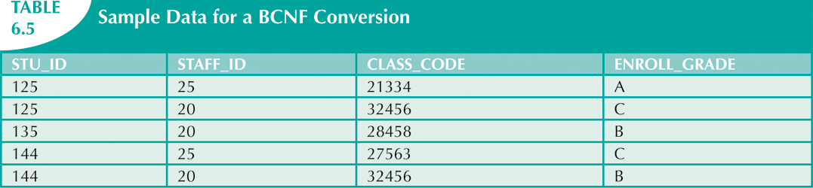
BCNF Example
Each CLASS_CODE uniquely identifies a class.
A student can take multiple classes.
A staff member can teach many classes, but
there is only one staff member per class.
If we know the student and staff number, then we
know the class and the grade.
So we have CLASS_CODE -> STAFF_ID.
(STU_ID, STAFF_ID) is the PK.

Slide 21
BCNF Example (ctd)
3NF but not BCNF
STU_ID
STAFF_ID
CLASS_CODE
ENROLL_GRADE
NOT a transitive dependency!
The table is trying to track both which staff are taking which classes and also
which grades students are getting in their classes.
To fix this, make (STU_ID, CLASS_CODE) the PK.
Then the table is in 1NF because CLASS_CODE -> STAFF_ID is a partial dependency.
Then convert to 3NF in the usual way.
STU_ID
CLASS_CODE
ENROLL_GRADE
CLASS_CODE
STAFF_ID
3NF and BCNF

Slide 22
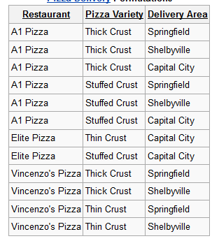
Multivalued Dependency
A multivalued dependency occurs if a set of attributes determines multiple values of two other sets of attributes which are independent of each other.
This table IS in 3NF.
What's the PK?

Slide 23
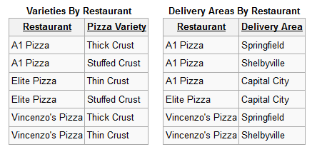
Dealing with Multivalued Dependencies
What we would like is the following, but this results in multi-valued attributes.
Restaurant | Pizza Variety | Delivery Area
A1 Pizza | Thick Crust, Stuffed Crust | Springfield, Shelbyville, Capital City
Elite Pizza | Thin Crust, Stuffed Crust | Capital City
Vincenzo's Pizza | Thick Crust, Thin Crust | Springfield, Shelbyville
Decompose into 2 separate tables:

Slide 24
Fourth Normal Form (4NF)
A table is in 4th normal form (4NF) if it is in BCNF and contains no multivalued dependencies.
Good database design methodologies should result in tables that are in 4NF.

Slide 25
Normalization and Database Design
Normalization is used in 2 situations:
Designing a new database.
Modifying an existing database.
Normalization should be part of the database design process.
Make sure that proposed entities meet at least 3rd normal form before table structures are created.
Many real-world databases have been improperly designed or burdened with anomalies.
You may be asked to redesign and modify existing databases.
There are other important aspects of good database design besides normalization.
E.g. derived attributes violate normalization. But derived attributes may still be worth adding, to save computing them each time.

Slide 26
Denormalization
Conforming to normalization requirements expands the number of database tables.
Since this reduces data redundancy, creation of normalized table is an important database design goal.
However, efficient processing is also an important database design goal.
Therefore in some circumstances denormalization may be useful.
This is done by joining multiple tables together to improve processing speed.
In operational databases, most of the time is spent inserting, updating and deleting data, so normalization is effective.
In analytical databases (e.g. data warehouses and data marts), most of the time is spent querying and processing the data, so normalization is not as important.

